Slide 1
St. Xavier’s College Ranchi.
My College in my eyes.

Slide 2
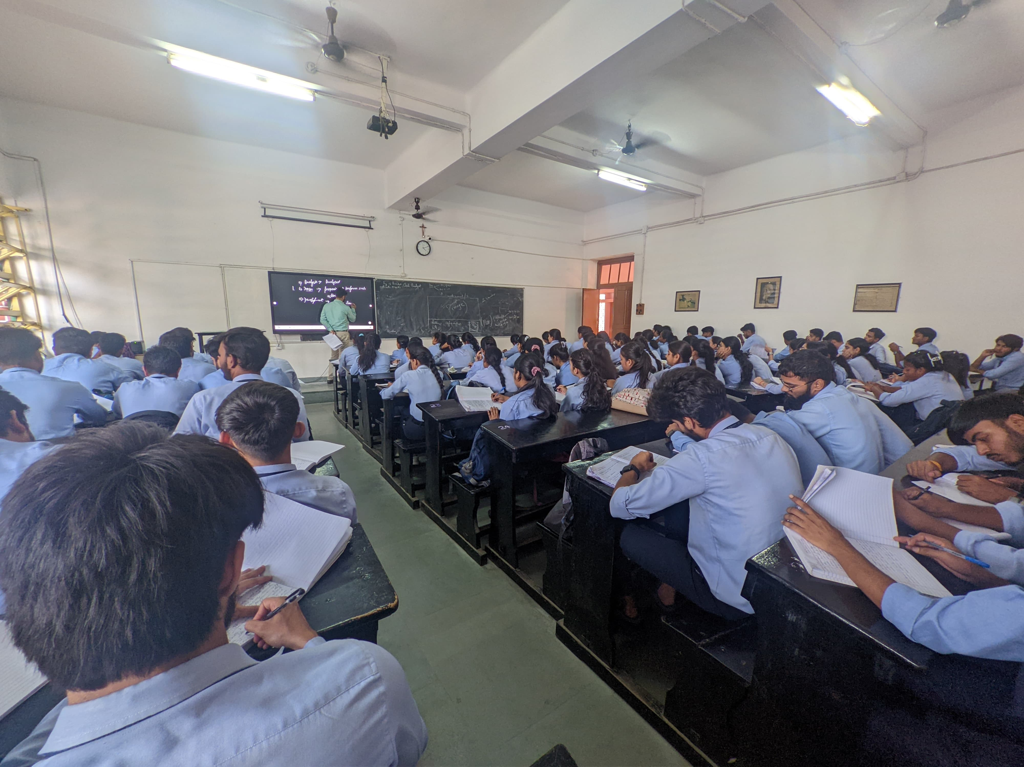
Class Room
The college classroom serves as a transformative sanctuary, where the seeds of knowledge are sown and minds are shaped. Within its walls, students embark on journeys of discovery, guided by passionate educators who inspire curiosity and critical thinking. It is a space where ideas are exchanged freely, debates flourish, and friendships are forged through collaborative learning. With its conducive environment for academic growth and personal development, the college classroom lays the foundation for future success and empowers students to pursue their dreams with confidence and determination.

Slide 3
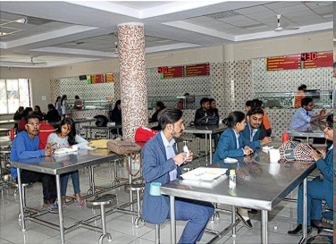
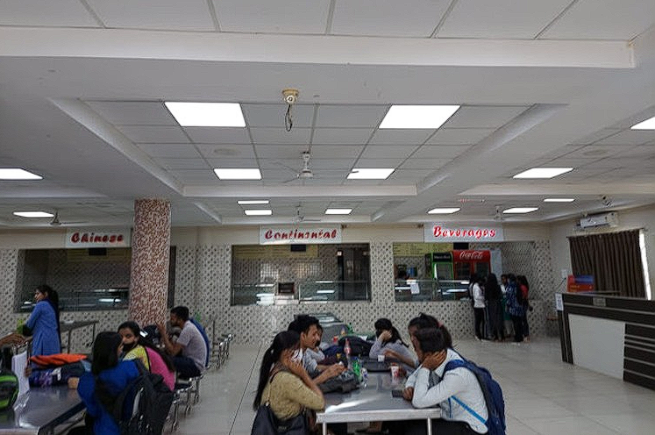
Canteen & Cafeteria
The college canteen is a vibrant hub pulsating with the rhythm of student life, where appetites are sated and friendships are nourished. It serves as more than just a place to grab a meal; it's a social melting pot where students from diverse backgrounds come together to unwind, share stories, and build lasting connections. With its inviting atmosphere and delicious offerings, the canteen fosters a sense of camaraderie and belonging within the campus community, creating cherished memories that complement the academic journey with moments of joy and camaraderie.

Slide 4
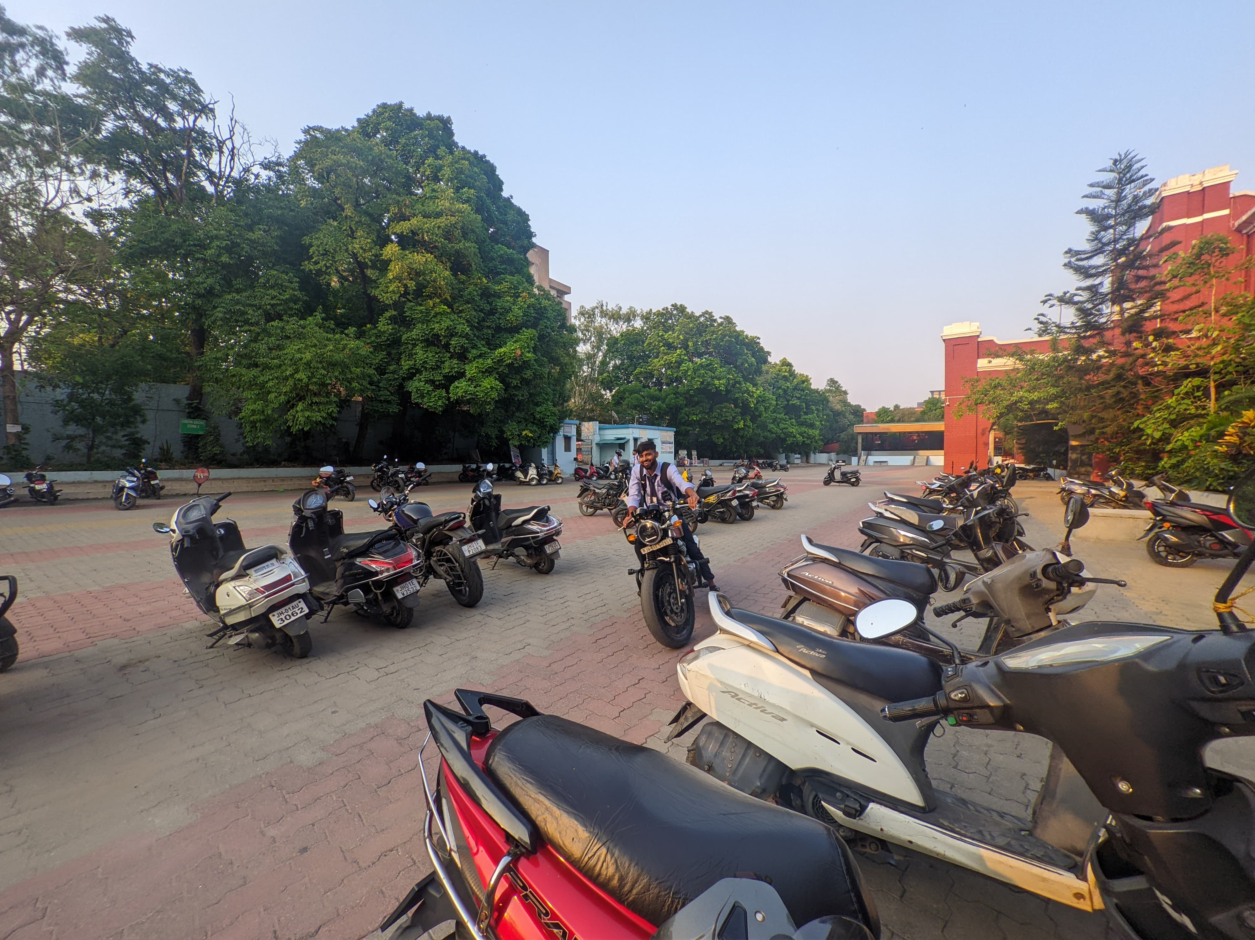
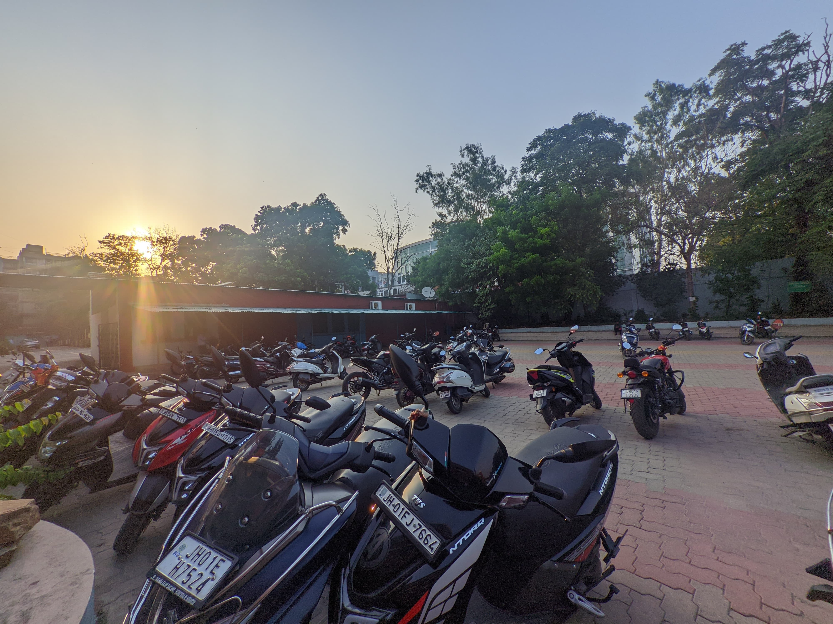
Parking
College parking can offer several advantages, especially in fostering a sense of community and convenience. Having designated parking areas on campus ensures that students, faculty, and visitors have a secure and reliable place to leave their vehicles, reducing the stress of finding a spot. Additionally, many colleges offer well-maintained, well-lit parking facilities that enhance safety and ease of access to campus buildings. This convenience allows students to maximize their time on academic and extracurricular activities, contributing to a more productive and engaging college experience.
College parking lots serve as more than just spaces for vehicles; they are hubs of connectivity and convenience. Despite the hustle and bustle, they provide a sense of security and belonging to students, faculty, and visitors alike. In these lots, chance encounters spark friendships, impromptu study groups form, and ideas blossom. They're not merely places to park cars but vibrant nodes of campus life, fostering a sense of camaraderie and unity among those who share the academic journey.

Slide 5
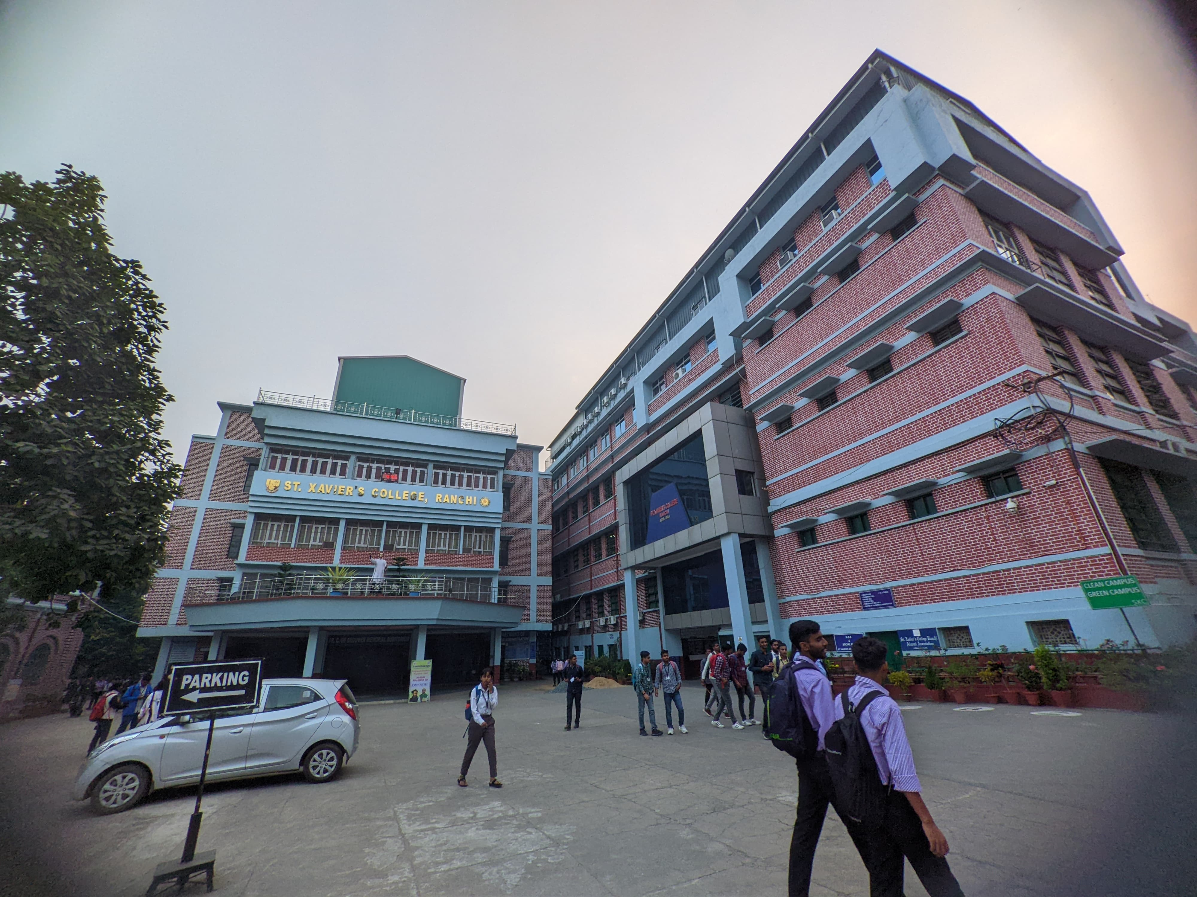
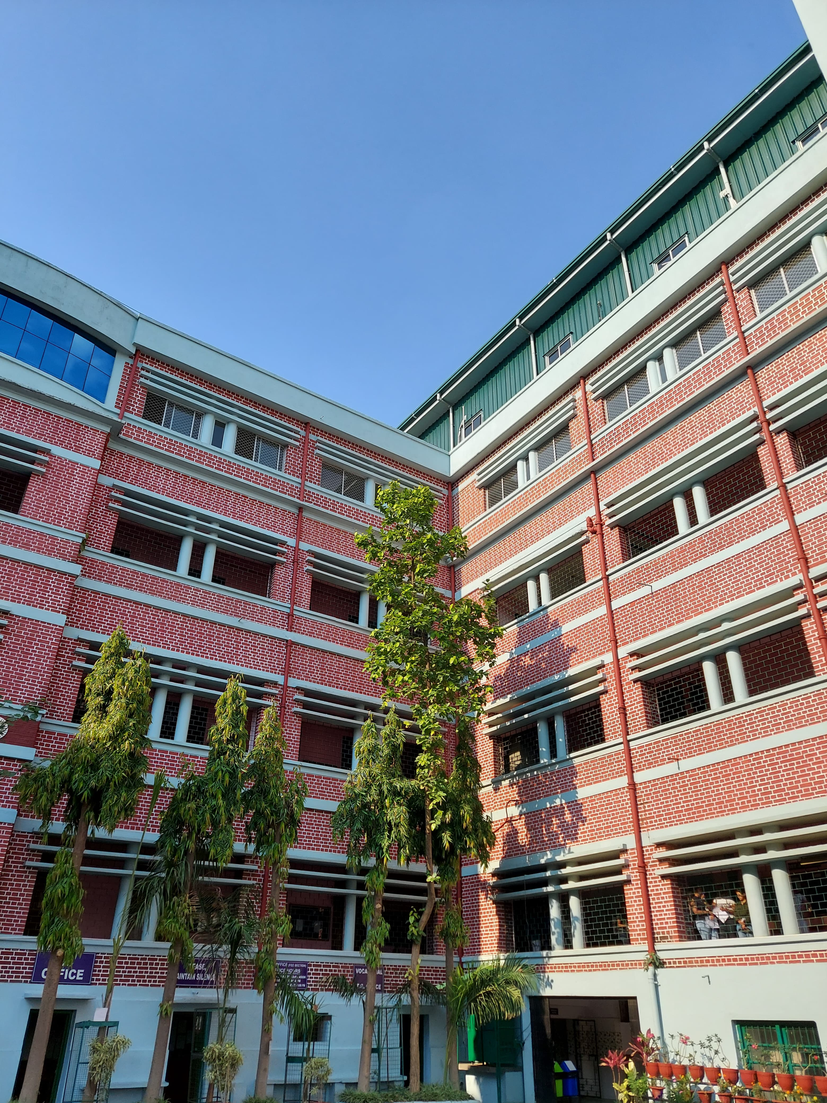
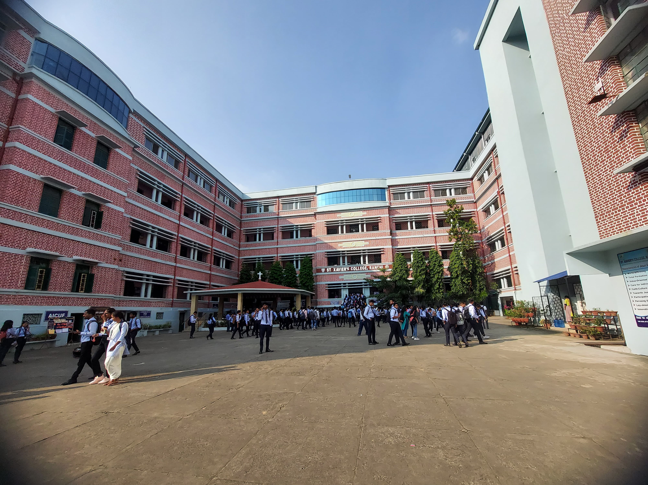
InfraStructure
College infrastructure plays a crucial role in enhancing the educational experience by providing state-of-the-art facilities and resources. Modern classrooms equipped with advanced technology facilitate interactive and innovative learning, while well-maintained libraries offer a vast array of resources for research and study. Additionally, recreational facilities, such as gyms and sports complexes, promote a healthy lifestyle and well-rounded development. Comfortable dormitories and dining halls ensure that students' living needs are met, creating a supportive environment that fosters academic success and personal growth. This robust infrastructure not only supports students' academic endeavors but also enriches their overall college experience.
The infrastructure of a college campus serves as the backbone of academic excellence and community cohesion. From state-of-the-art laboratories to inviting green spaces, every building and facility is meticulously designed to support learning, research, and social interactions. Beyond functionality, the architecture often embodies the institution's values and history, inspiring pride and a sense of belonging among students and faculty. Whether it's modern classrooms equipped with cutting-edge technology or historic landmarks that stand as testaments to tradition, the college infrastructure fosters an environment where knowledge thrives and connections flourish, enriching the collegiate experience for all.

Slide 6
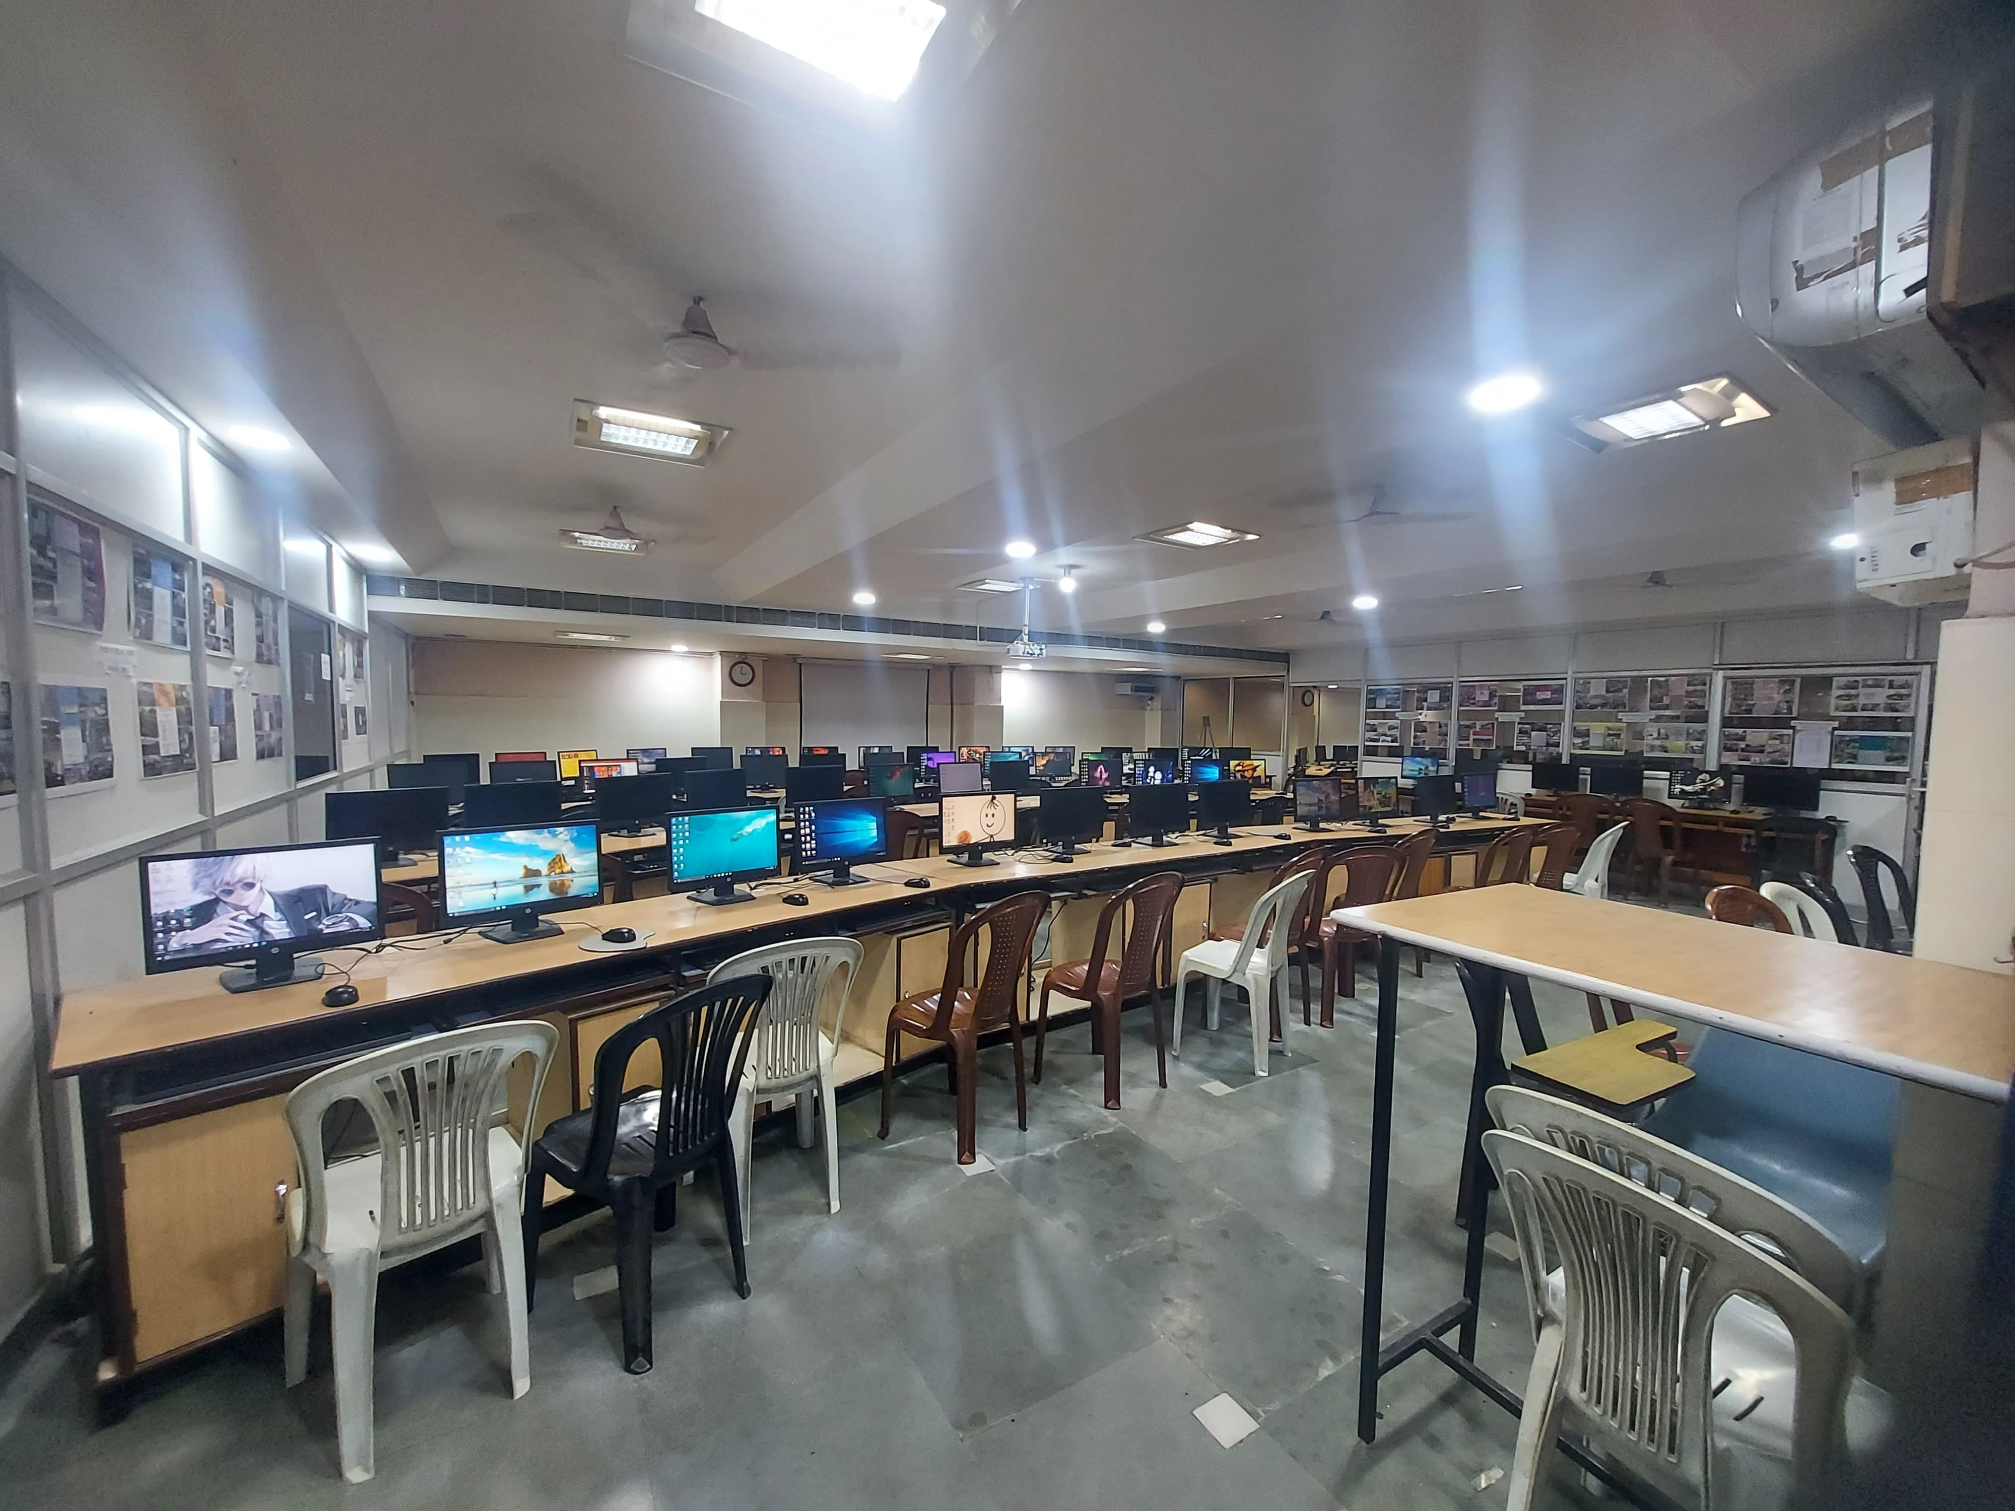
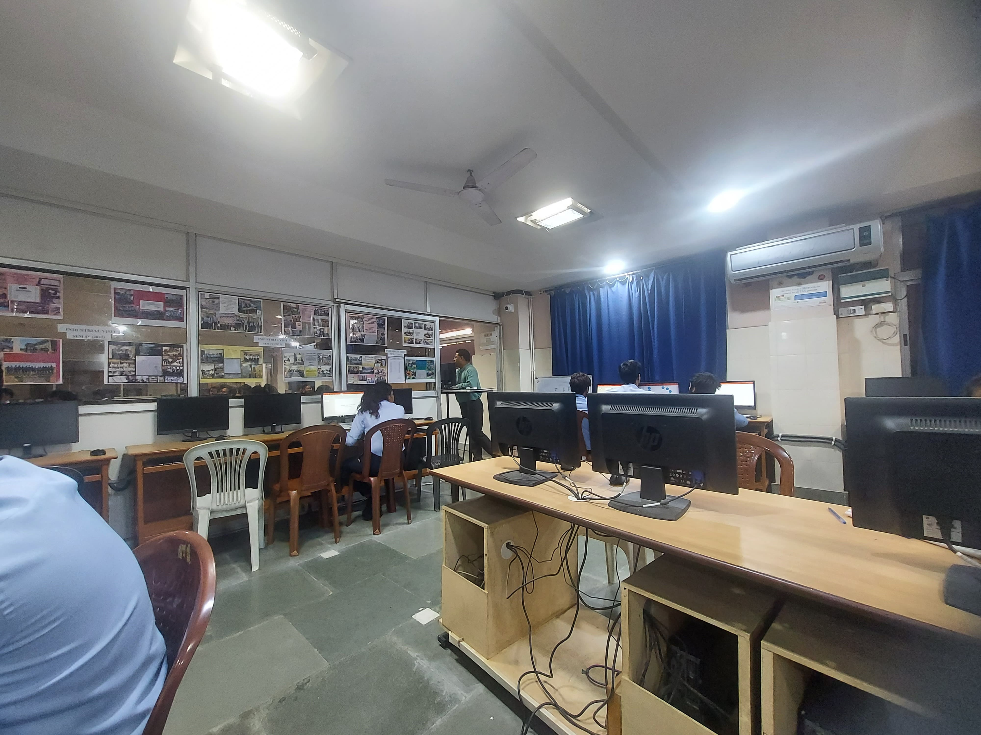
Computer Lab
A college computer lab is a vital asset that significantly enhances the learning environment for students. Equipped with the latest software and high-performance computers, it provides students with the tools they need to complete assignments, conduct research, and develop technical skills. The lab offers a collaborative space where students can work on group projects, share ideas, and receive assistance from knowledgeable staff. With extended hours of access, it ensures that all students, regardless of their personal resources, have the opportunity to utilize cutting-edge technology, thus leveling the playing field and promoting academic success.

Slide 7
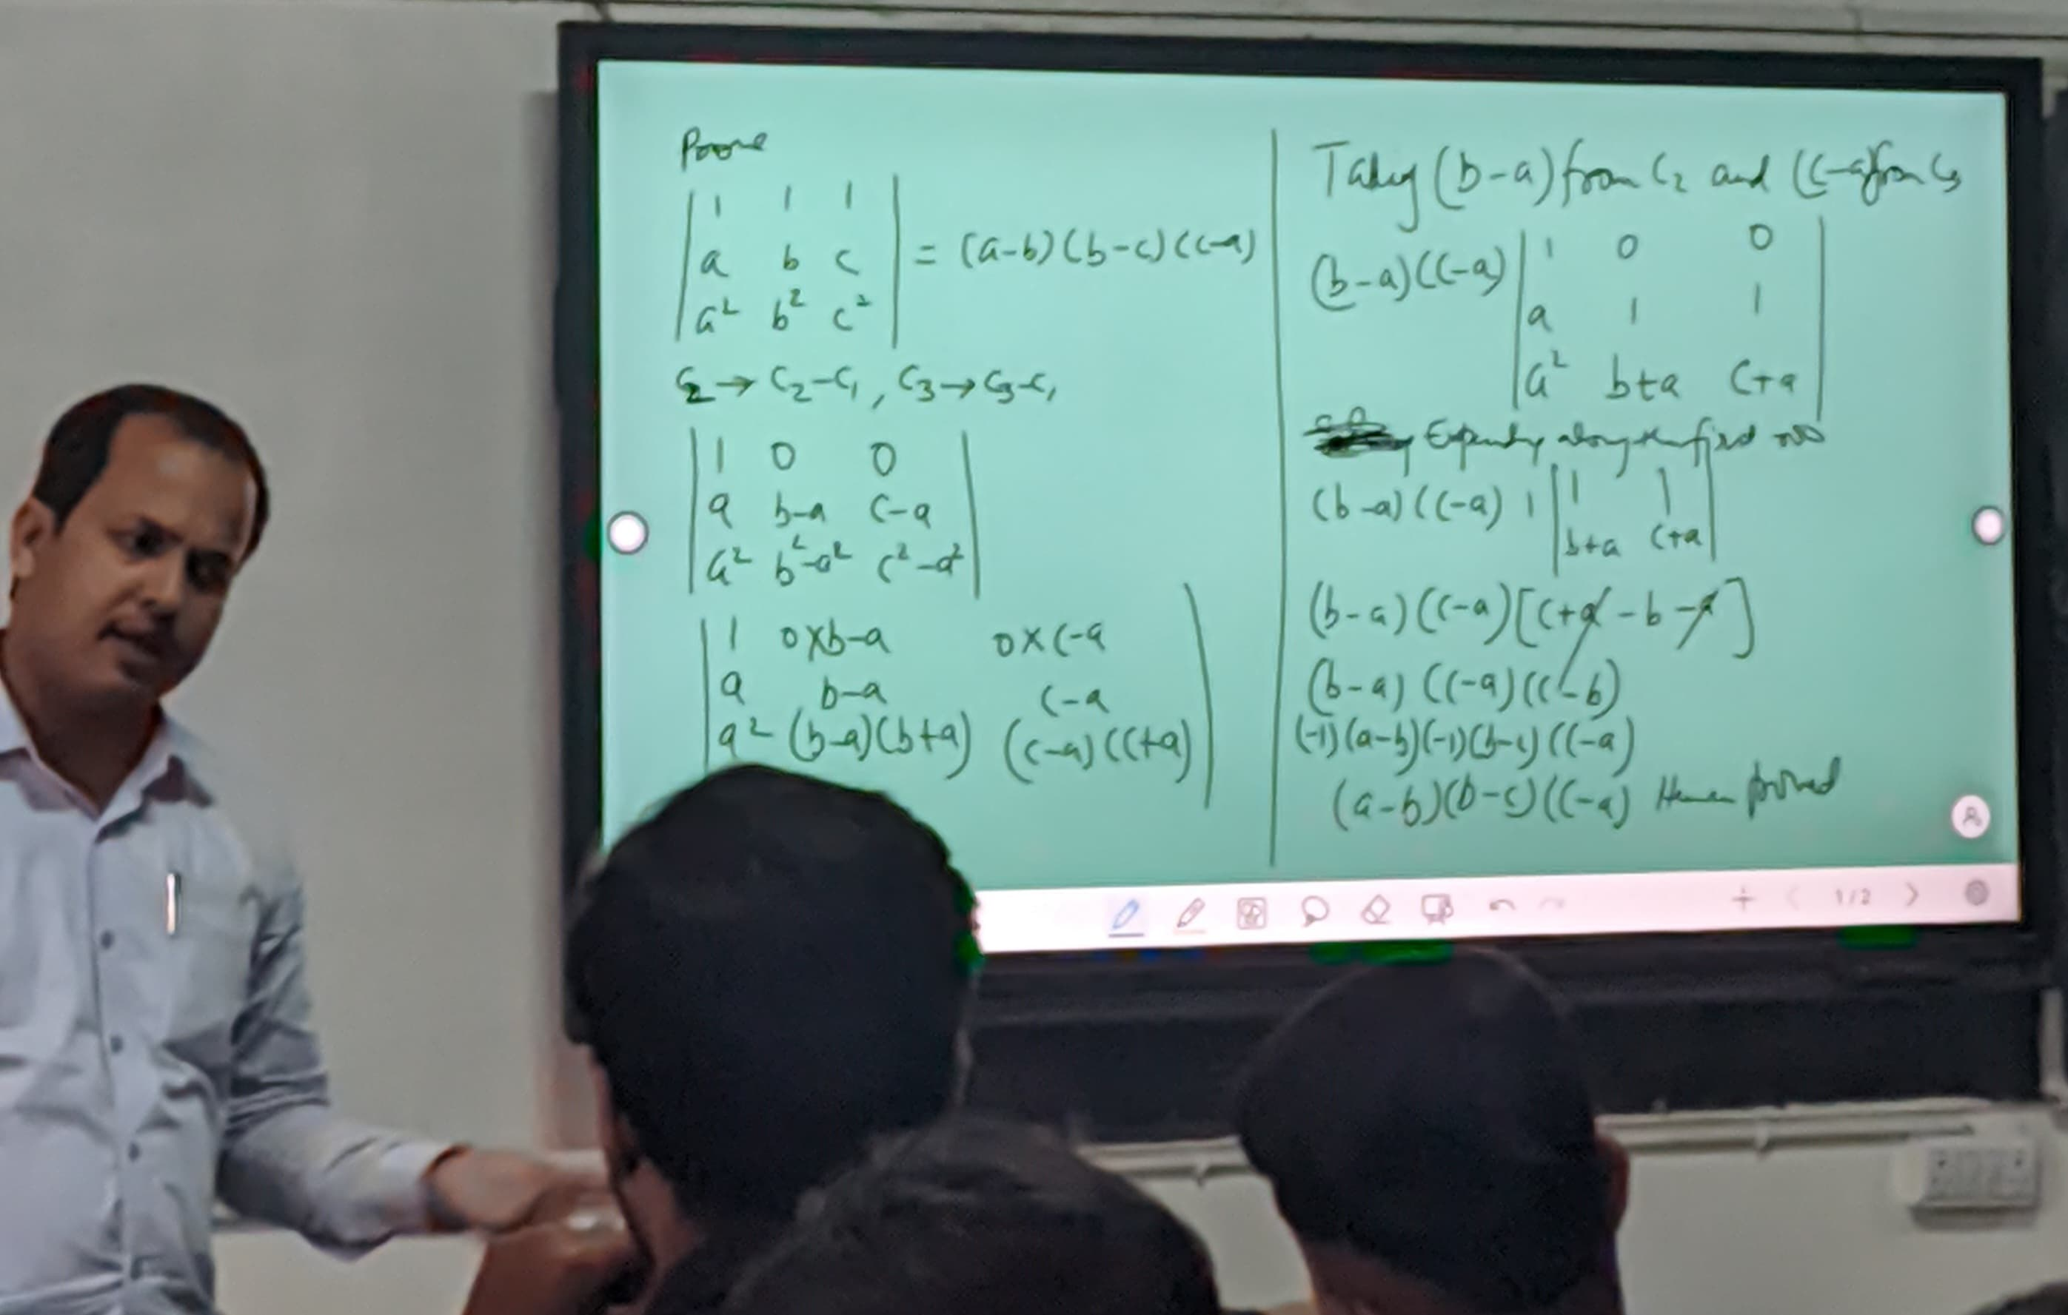
Excellent Teachers
College teachers are the cornerstone of the educational experience, bringing expertise, passion, and dedication to their classrooms. Their deep knowledge and enthusiasm for their subjects inspire students to explore and engage with new ideas, fostering a love of learning. By providing personalized guidance, feedback, and support, they help students overcome challenges and achieve their academic goals. Additionally, college teachers often serve as mentors, offering career advice and professional connections that extend beyond graduation. Their commitment to student success and lifelong learning creates a dynamic and supportive environment where students can thrive.

Slide 8
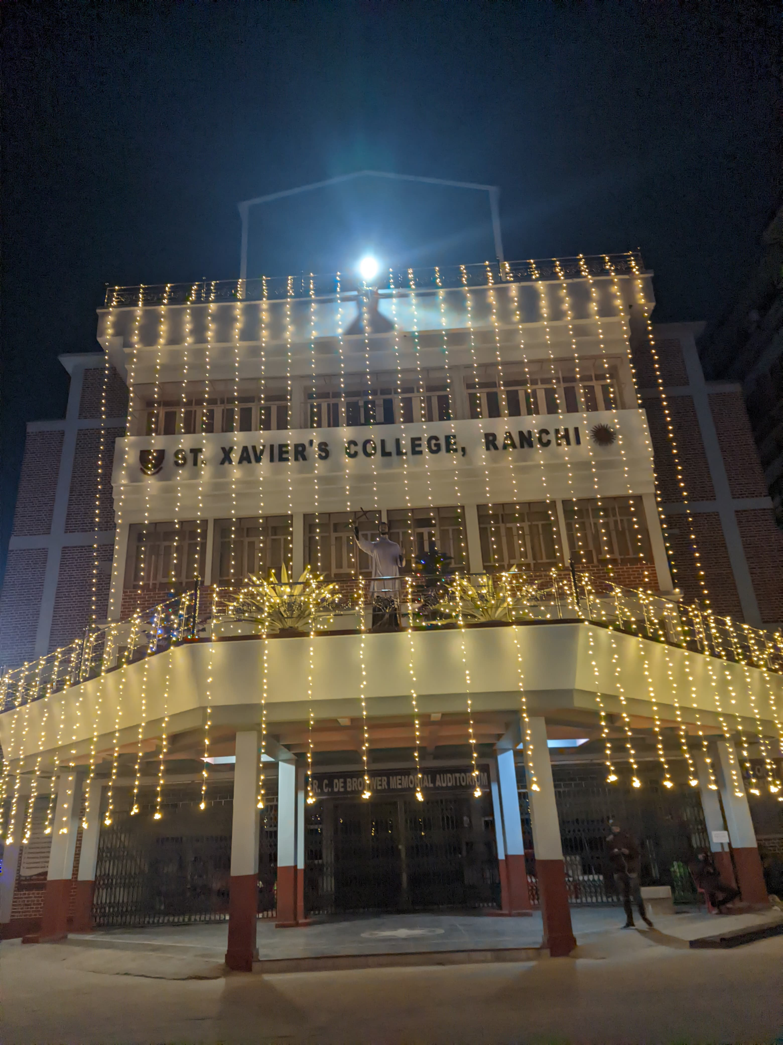
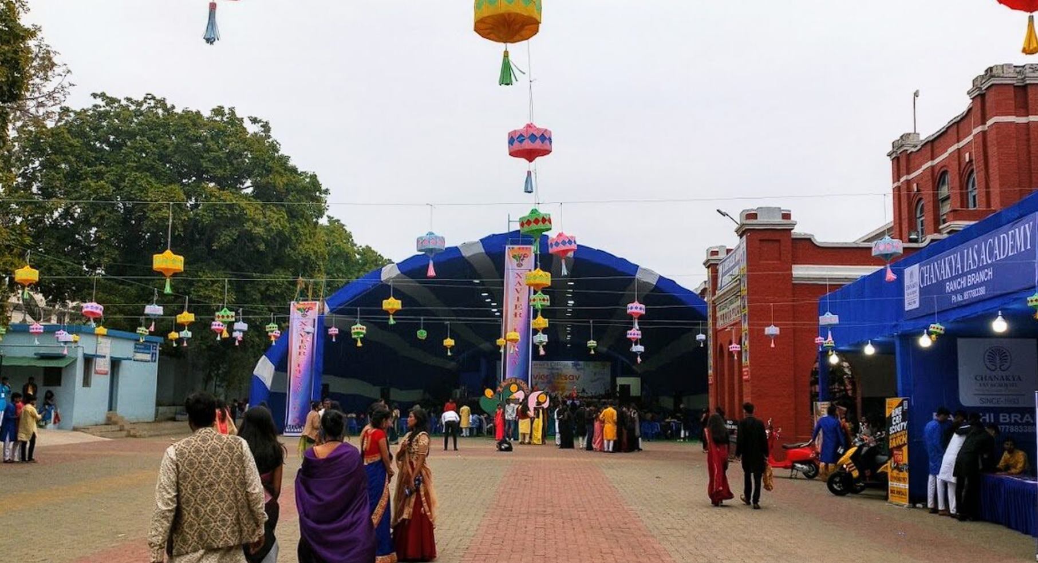
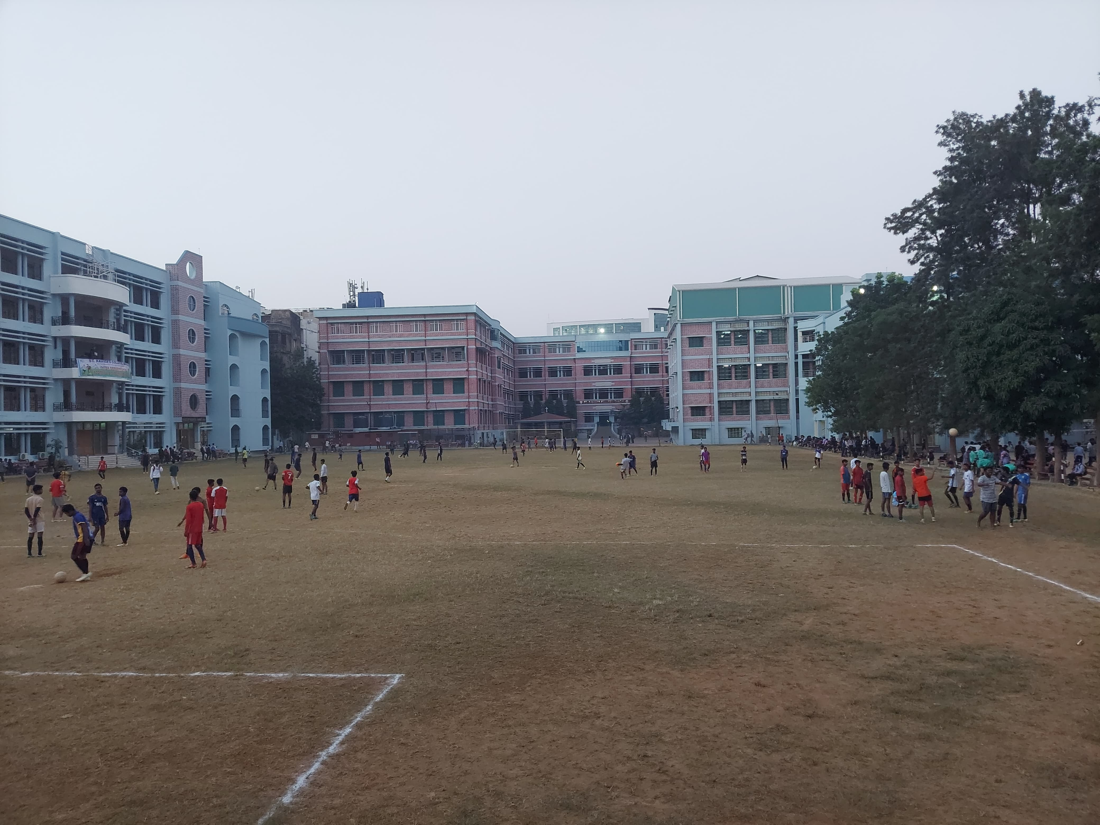
Events & Programs
College events and programs are essential in creating a vibrant and engaging campus life, offering students numerous opportunities for personal and professional growth. These activities, ranging from academic seminars and cultural festivals to career fairs and community service projects, provide a platform for students to explore diverse interests, develop new skills, and connect with peers and industry professionals. Participating in these events enhances the overall college experience by fostering a sense of community, encouraging collaboration, and building a strong network of relationships. Ultimately, college events and programs enrich students' lives, preparing them for future success both personally and professionally.

Slide 9
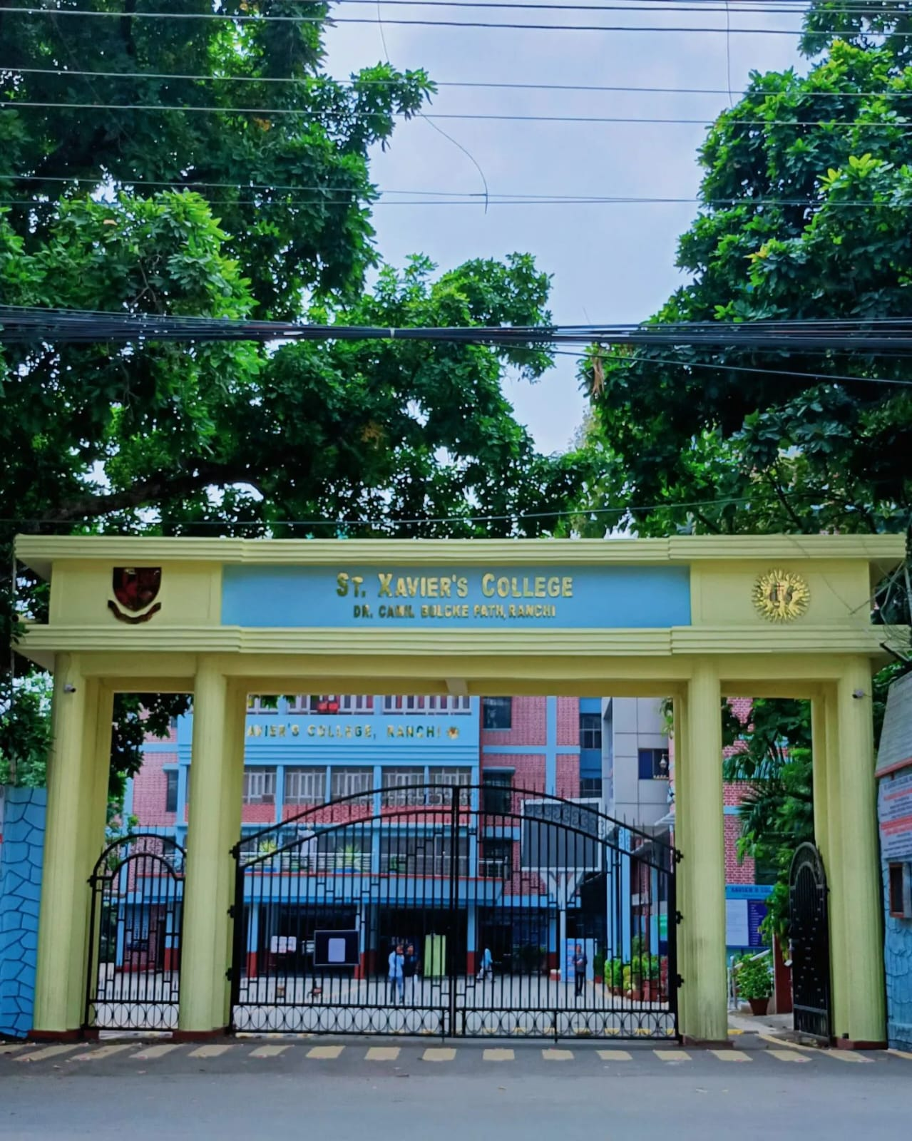
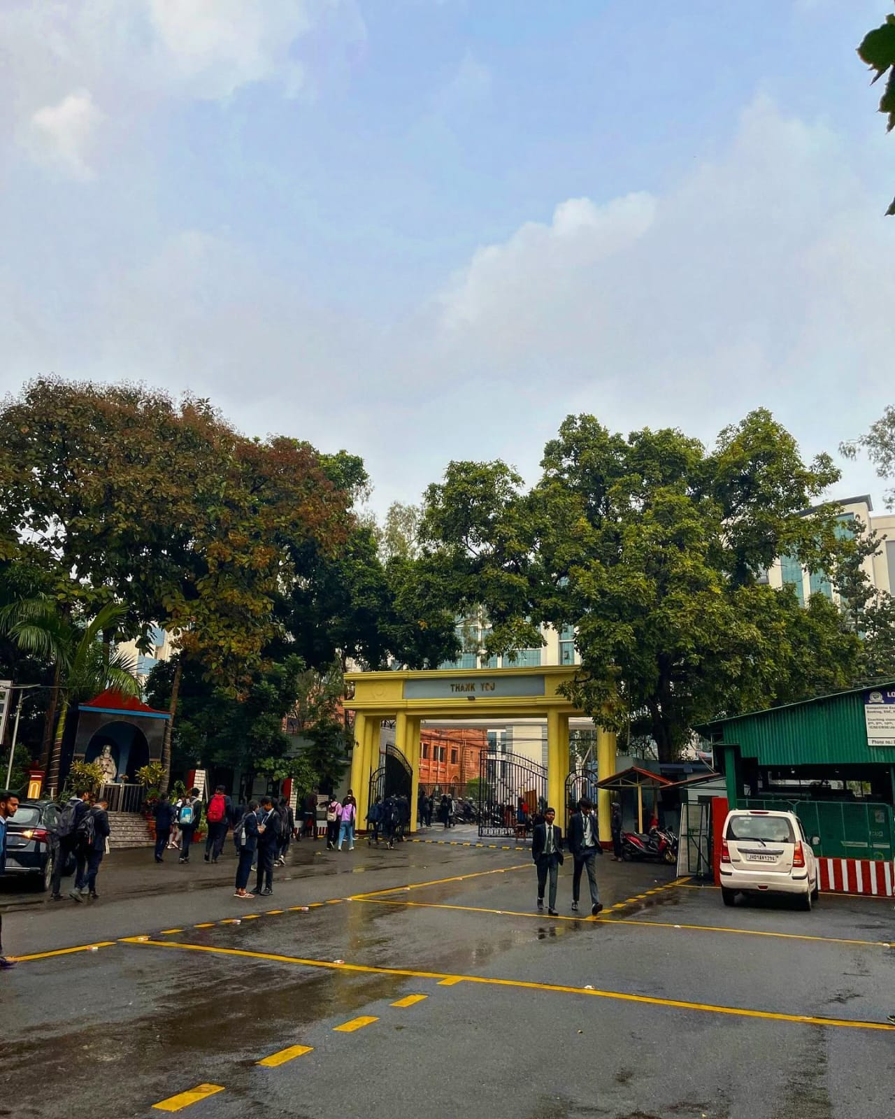
Entry & Exit Gate
A college's entry and exit gates serve as welcoming and secure thresholds that significantly enhance campus safety and aesthetics. These gates, often manned by security personnel and equipped with surveillance cameras, ensure a controlled and safe environment for students, faculty, and visitors. Their strategic placement and design contribute to smooth traffic flow, reducing congestion and making daily commutes more efficient. Additionally, well-designed gates add to the visual appeal of the campus, creating a positive first impression and fostering a sense of pride and belonging among the college community. Overall, these gates play a crucial role in maintaining a secure, organized, and inviting campus atmosphere.

Slide 10
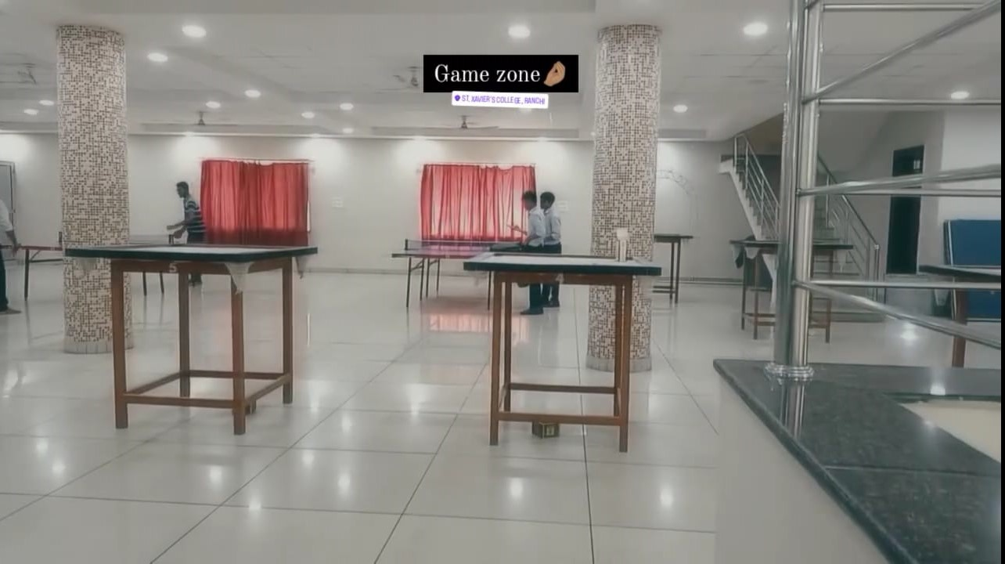
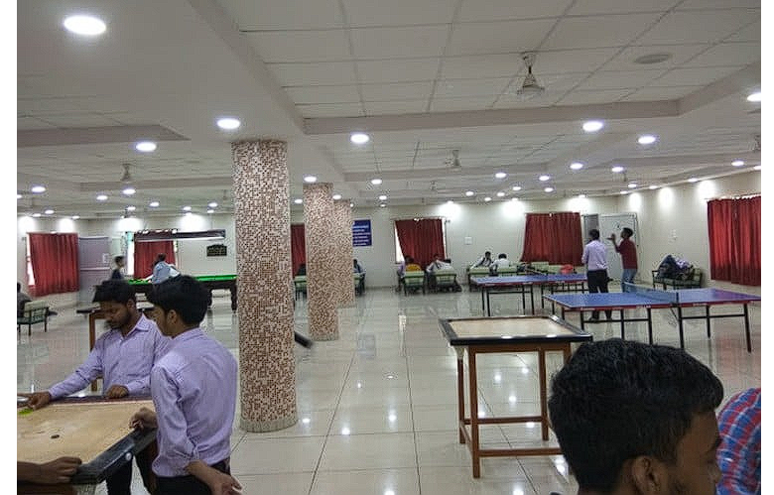
Game Zone
A college game zone is a fantastic addition to campus life, offering a fun and relaxing environment for students to unwind and socialize. Equipped with games like pool, table tennis, and Chess it fosters community, teamwork, and camaraderie. This recreational space enhances the college experience by balancing work and play, contributing to students' mental well-being and stress relief.

Slide 11
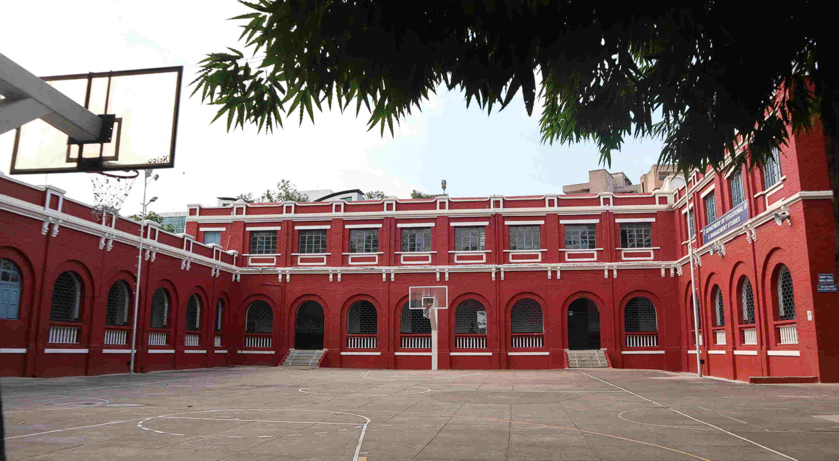
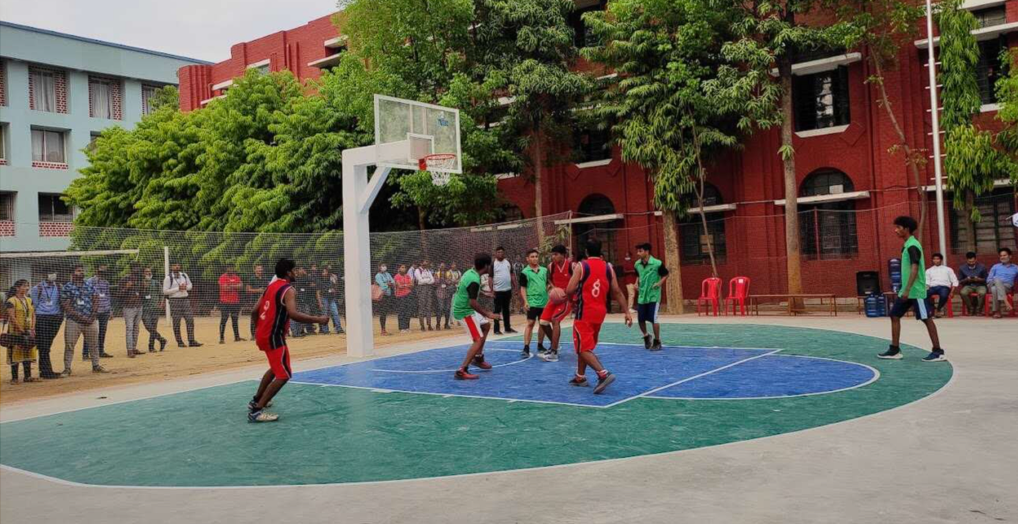
Football and Basketball Ground
A college football and basketball ground serves as a hub of athleticism, camaraderie, and school spirit, providing students with a venue to compete, cheer, and connect with their peers. These grounds not only host thrilling games but also foster a sense of community among students, alumni, and fans. Whether playing on the field or cheering from the stands, students are united by their passion for sports, promoting teamwork, leadership, and healthy competition. Additionally, these grounds serve as platforms for showcasing talent, instilling pride in the college, and creating lasting memories for all involved.

Slide 12
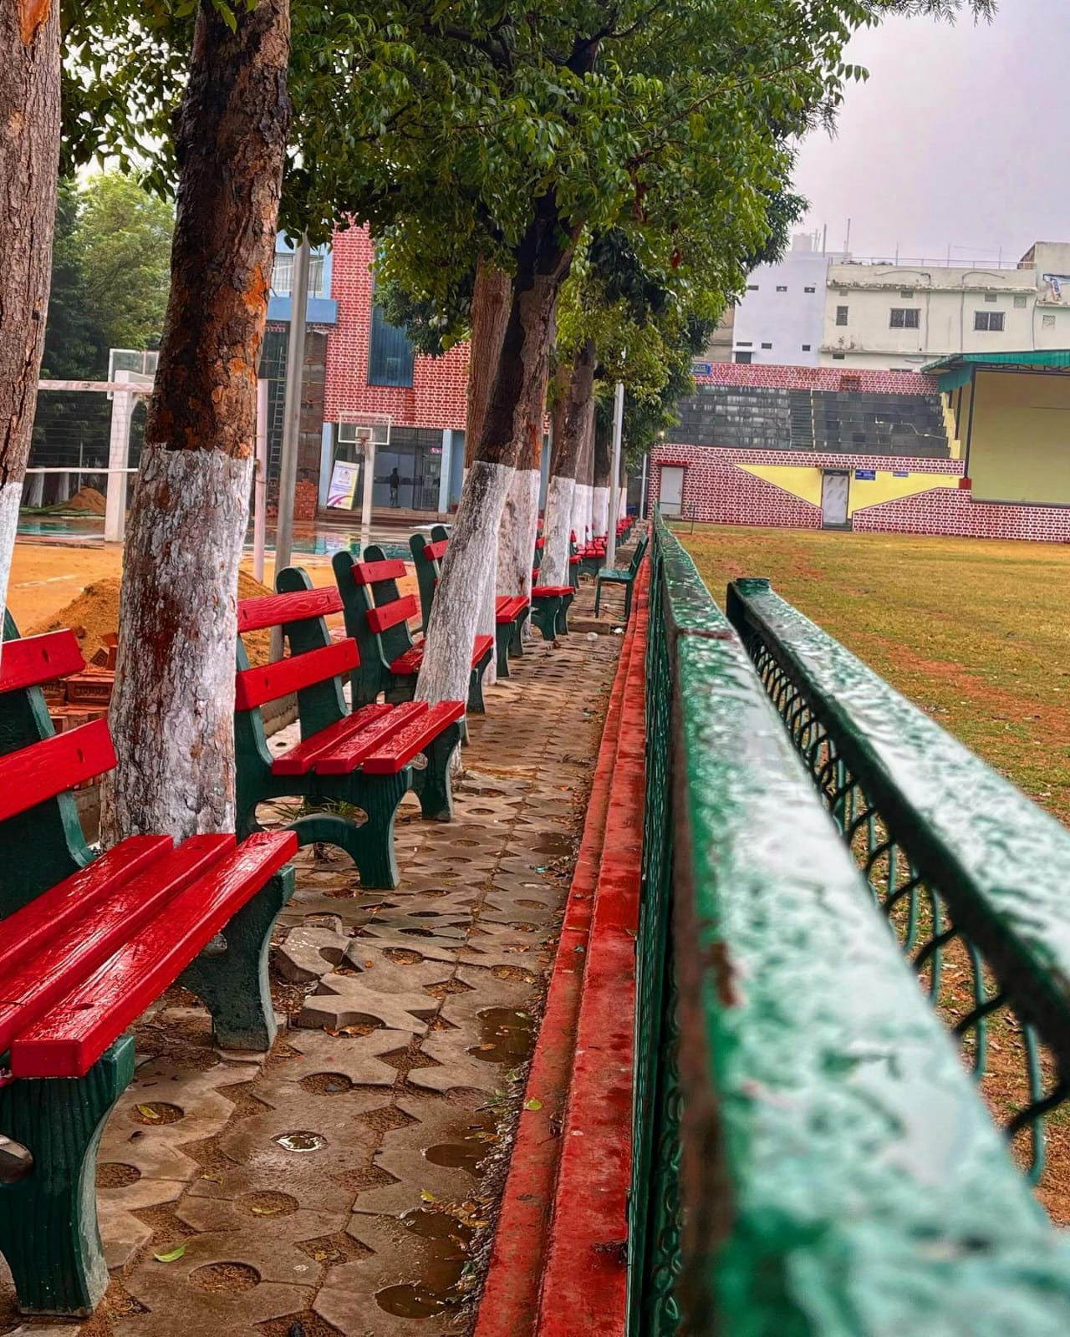

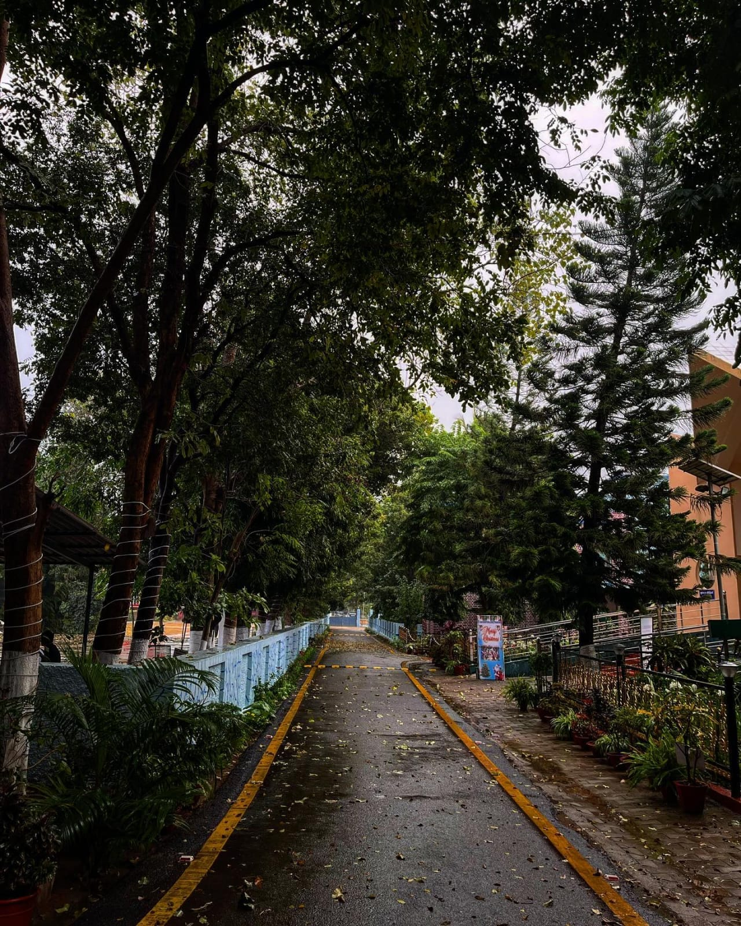
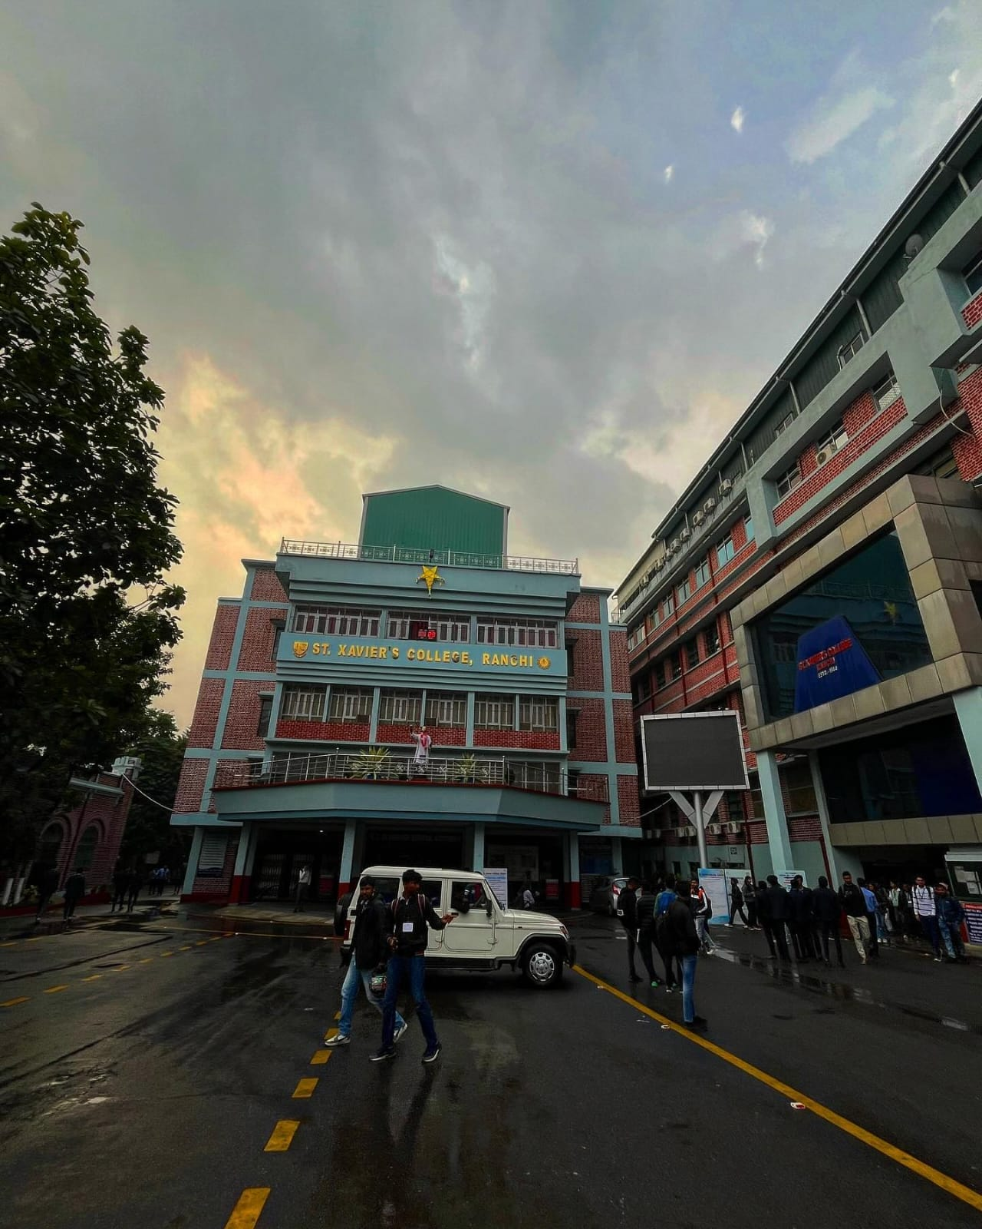
Aesthetic Scene
An aesthetic scene on a college campus offers a serene and inspiring backdrop for students to relax, reflect, and find creative inspiration. Whether it's a picturesque garden, a tranquil pond, or a striking piece of public art, these scenes provide a welcome respite from the demands of academic life. Students can find solace and rejuvenation amidst the beauty of nature or the thought-provoking presence of art, enhancing their overall well-being and sense of belonging. Aesthetic scenes not only beautify the campus but also serve as gathering spaces for students to connect, study, or simply appreciate the beauty that surrounds them

Slide 13
Thank You PPT By- 635

